Slide 1

Sentiment Analysis of Amazon Reviews
on Musical Instruments
Student
Zohreh Soltani
Mentor
Kevin Glynn

Slide 2
BUSINESS PROBLEM
Which products should be kept, dropped from Amazon’s product roster
Can we associate positive and negative words/sentiments for each product in Amazon’s Catalog by using Sentiment analysis, can we predict scores for reviews based on certain words
Can we predict scores for reviews based on certain words
Source of the Data
http://jmcauley.ucsd.edu/data/amazon/

Slide 3
ASSUMPTION
We’re assuming that sample size of 10K examples are sufficient to represent the entire population of sales/reviews
We’re assuming that the information in the text reviews of each product is rich enough to train a sentiment analysis
classifier with accuracy (hopefully) > 70%

Slide 4
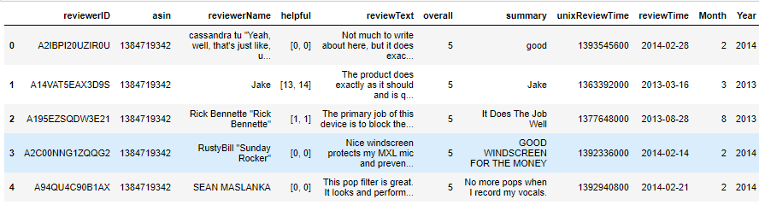
DATASET
ReviewerID - ID of the reviewer, e.g. A2SUAM1J3GNN3B→ Object
Asin - ID of the product, e.g. 0000013714 → Object
Reviewer Name - name of the reviewer → Object
Helpful - helpfulness rating of the review, e.g. 2/3 → Object
Review Text - text of the review → Object
Overall - rating of the product → int64
Summary - summary of the review → object
Unix Review Time - time of the review (unix time) → int64
Review Time - time of the review (raw) → object

Slide 5
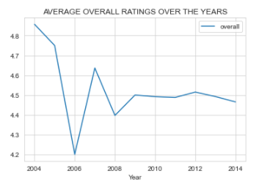
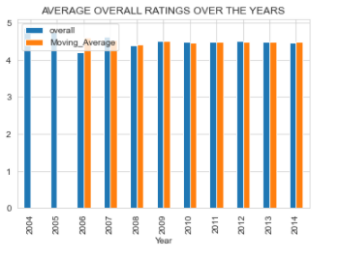
Year overall
2004 4.857
2005 4.750
2006 4.200
2007 4.636
2008 4.397
2009 4.500
2010 4.491
2011 4.487
2012 4.514
2013 4.492
2014 4.465
EXPLORATORY DATA ANALYSIS
Total number of reviews: 10261
Total number of unique products: 900
Percentage of reviews with neutral sentiment : 7.52%
Percentage of reviews with positive sentiment : 87.93%
Percentage of reviews with negative sentiment : 4.55%

Slide 6
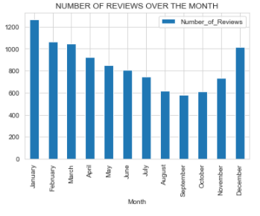
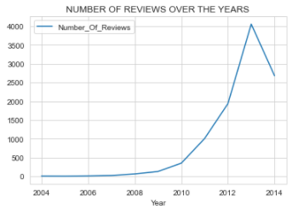
Year Number Of
Reviews
2004 7
2005 4
2006 10
2007 22
2008 63
2009 128
2010 350
2011 1007
2012 1936
2013 4055
2014 2679
1. As the analysis indicates, products had the highest scores in 2004 and 2005. The highest number of reviews were received from the customers in 2013. This could be due to the highest sale or promotions /incentives for the reviews written in latter years especially in 2013.
2. During a year, the first three months of the year have more reviews written on products. This could be resulted from the highest sale in the last months of the year such as November and December. However, this dataset does not include the sale data to analyze this correlation.
Month Number Of
Reviews
January 1266
February 1063
March 1043
April 922
May 851

Slide 7
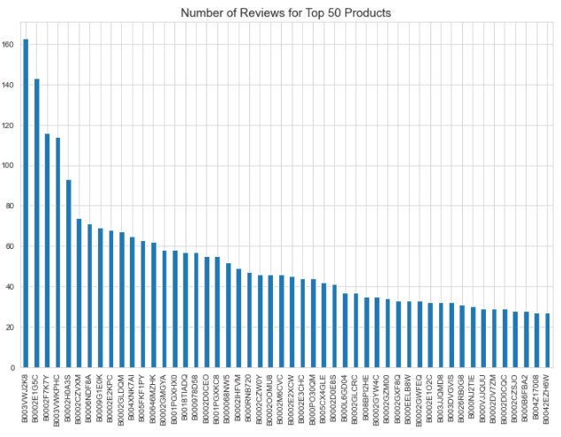
CLOSER LOOK AT PRODUCTS
The number of unique asins (product ID): 900
5 is the minimum count of reviews received by products
163 is the maximum count of reviews received by products
The average count of reviews received by products: 11.40
Statistics of Reviews for Products
count 900.00
mean 11.40
std 12.933
min 5
25% 6
50% 8
75% 12
max 163

Slide 8
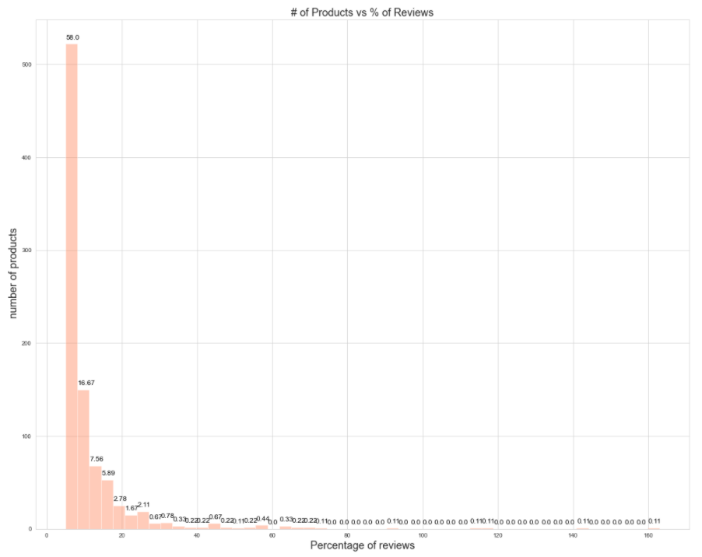
Almost 90 pct. of products have less than 20 reviews

Slide 9
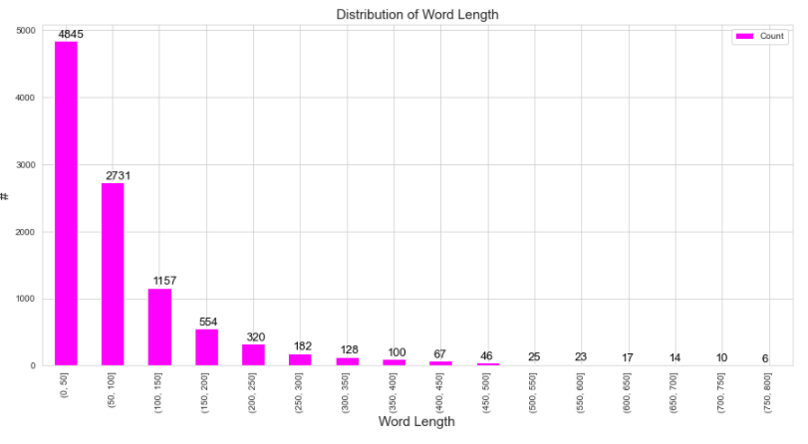
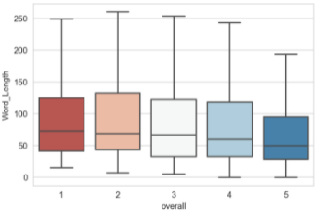
CLOSER LOOK AT REVIEWS
5-star reviews had the lowest median word count (50 words), while 1-star reviews had the largest median word count (73 words)

Slide 10
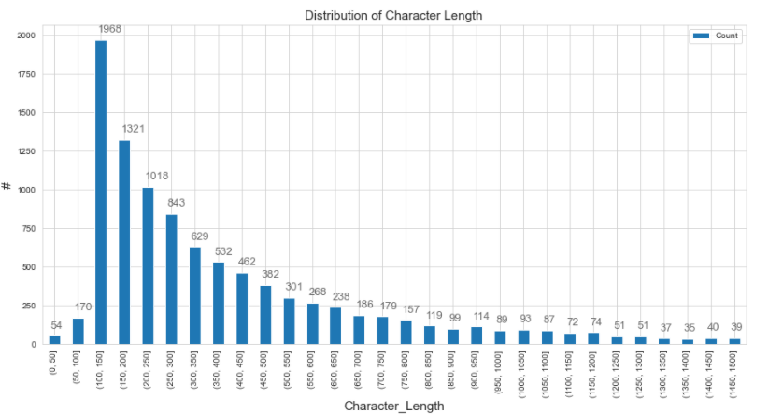
CLOSER LOOK AT REVIEWS

Slide 11
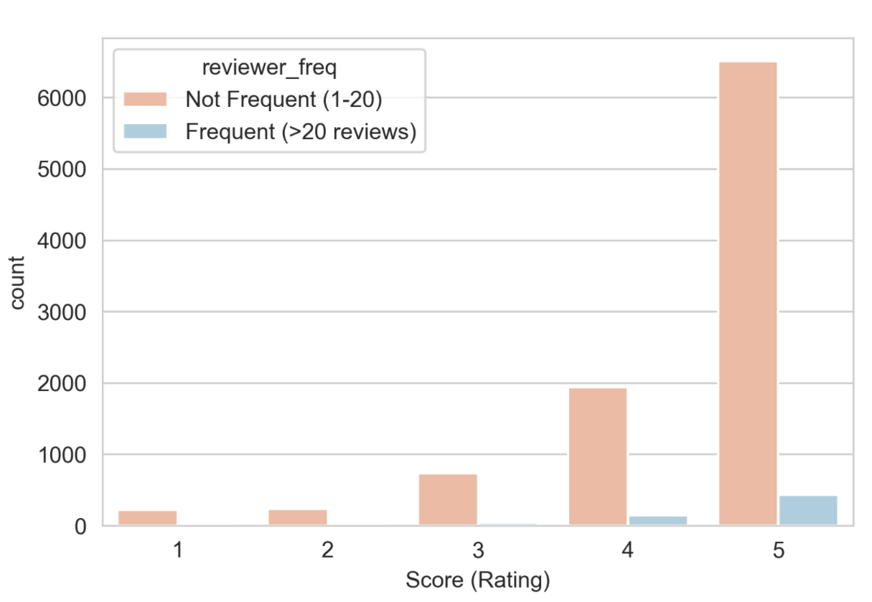
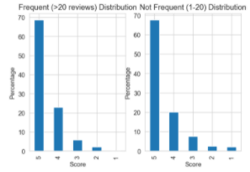
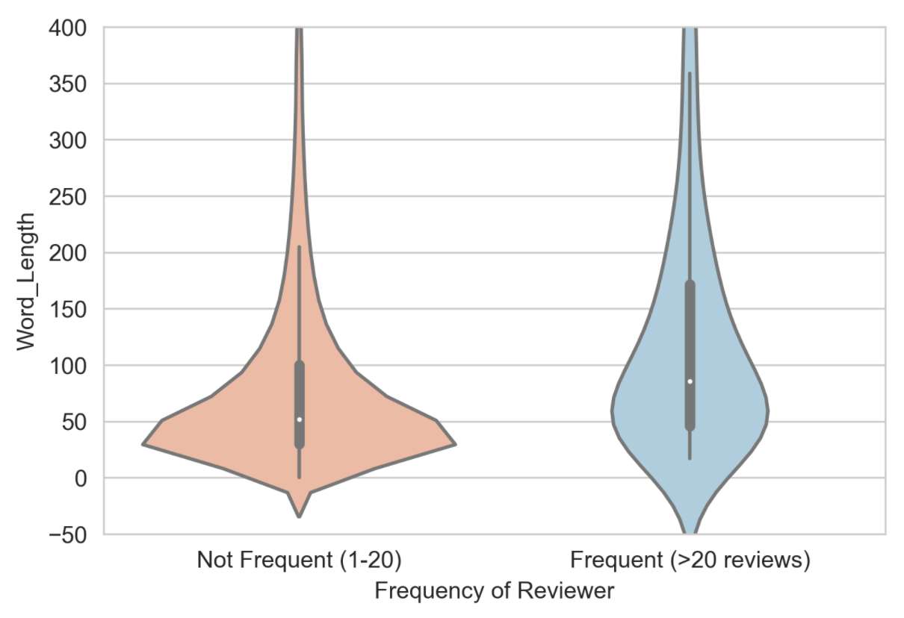
CLOSER LOOK AT REVIEWERS
1-frequency of reviewers
2-Are frequent reviewers more discerning?
Only 6 percent of reviewers have reviews more than 20.
3-Are frequent reviewers more verbose?¶

Slide 12
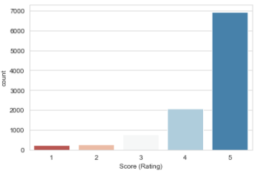
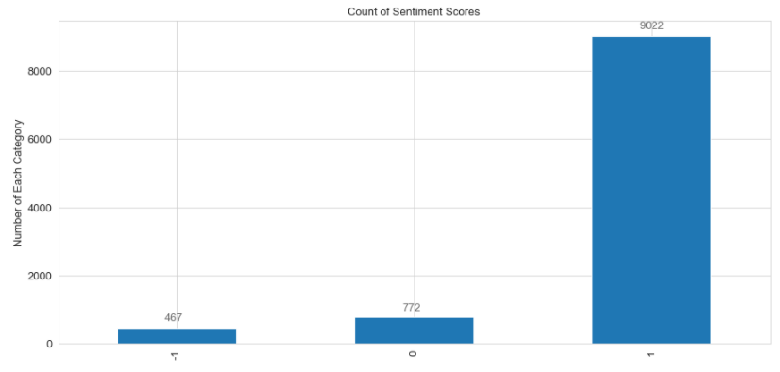
DATA PROCESSING AND FEATURE ENGINEERING
Labeling the Dataset
def sentiments(rating):
if (rating == 5) or (rating == 4):
return 1
elif rating == 3:
return 0
elif (rating == 2) or (rating == 1):
return -1

Slide 13
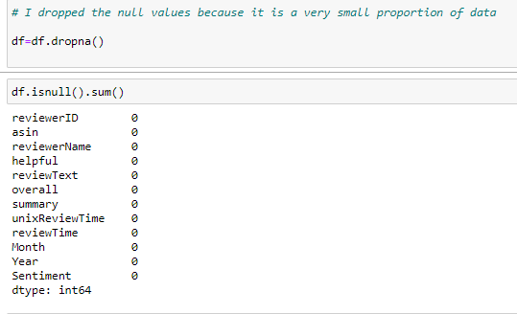
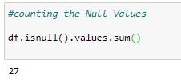
Handling the null values
Remove any 'neutral' ratings equal to 3
df = df[df['overall'] != 3]
to absolutely ensure all data type in review Text are string

Slide 14
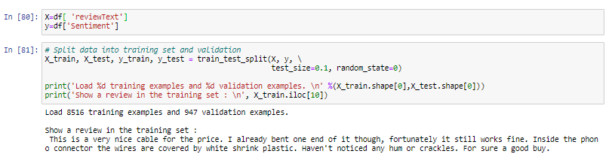
SPLIT INTO TRAIN /TEST DATASET
MODELING
remove non-character such as digits and symbols
convert to lower case
remove stop words such as "the" and "and" if needed
convert to root words by stemming if needed
Step 1. Preprocess raw reviews to cleaned reviews
Step 2. Create BoW using CountVectorizer / Tfidfvectorizer in sklearn
Step 3. Transform review text to numerical representations (feature vectors)
Step 4. Fit feature vectors to supervised learning algorithm (e.g. Naive Bayes, Logistic regression, etc.)
Step 5. Improve the model performance by Grid Search

Slide 15
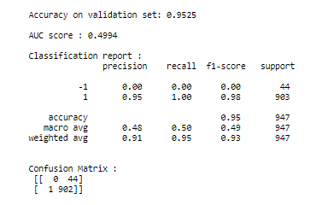
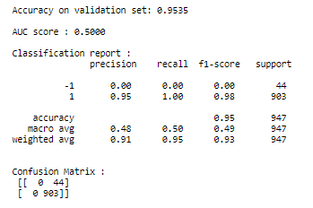
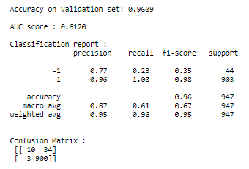
CountVectorizer with Multinomial Naive Bayes
Tfidfvectorizer with Logistic Regression
(Benchmark Model)
(After Grid search hyper-parameter tuning)

Slide 16
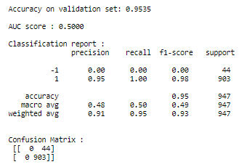
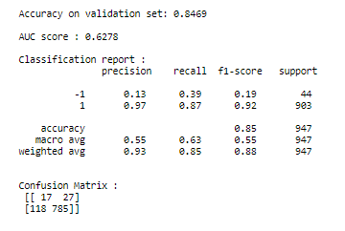
Word2Vec
Another common approach of word embedding is prediction based embedding, such as Word2Vec model. In gist, Word2Vec is a combination of two techniques: Continuous Bag of Words (CBoW) and skip-gram model. Both are shallow neural networks which learn weights for word vector representations.
In this part, we will train Word2Vec model to create our own word vector representations using genism library. Then we fit the feature vectors of the reviews to Random Forest Classifier. Here's the workflow of this part.
Step 1. Parse review text to sentences (Word2Vec model takes a list of sentences as inputs)
Step 2. Create vocabulary list using Word2Vec model
Step 3. Transform each review into numerical representation by computing average feature vectors of words therein
Step 4. Fit the average feature vectors to Random Forest Classifier
Under sampling
RandomForestClassifier before under sampling the majority class
RandomForestClassifier after under sampling the majority class

Slide 17
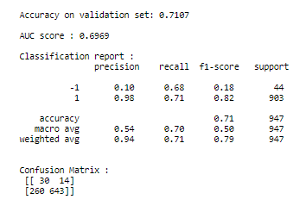
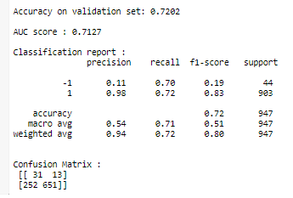
BalancedRandomForestClassifier
Under sampling
RandomForestClassifier before resampling
RandomForestClassifier after resampling

Slide 18
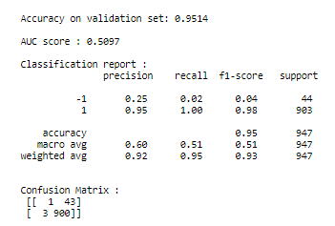
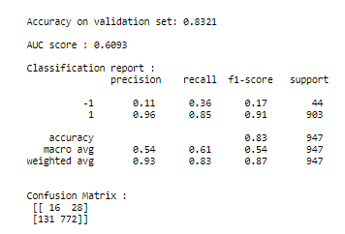
XGBoost Classifier
Under sampling
XGBoost classifier before resampling
XGBoost classifier after resampling

Slide 19
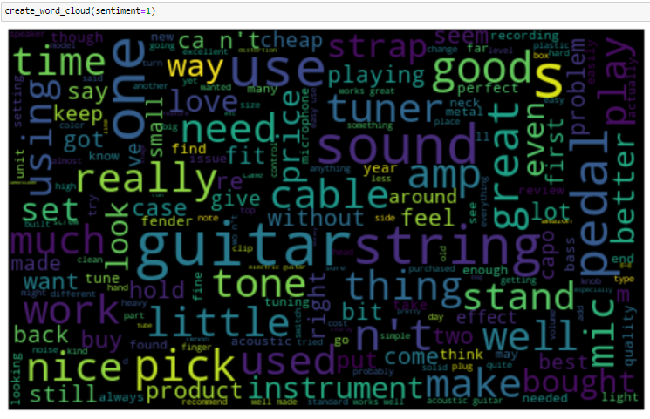
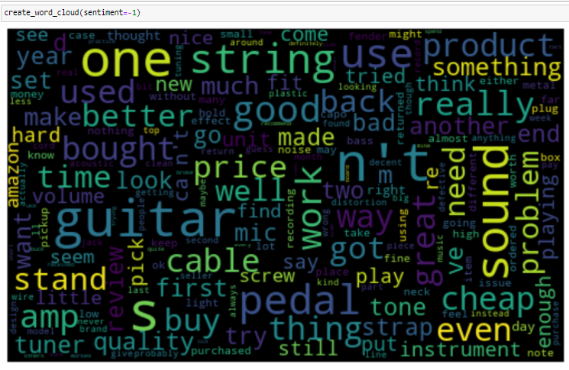
Word Cloud

Slide 20
Limitation and Improvements
1- The correction method for the imbalanced data did not help as much as expected. The other methods than under sampling should be tried. Or more sample has to be collected if possible.
2- Using Deep Learning algorithm also can result in the better predictive models
3- Word Cloud with limited number of words can be of value to show the difference between the common word in different sentiments clearer.

